Slide 1
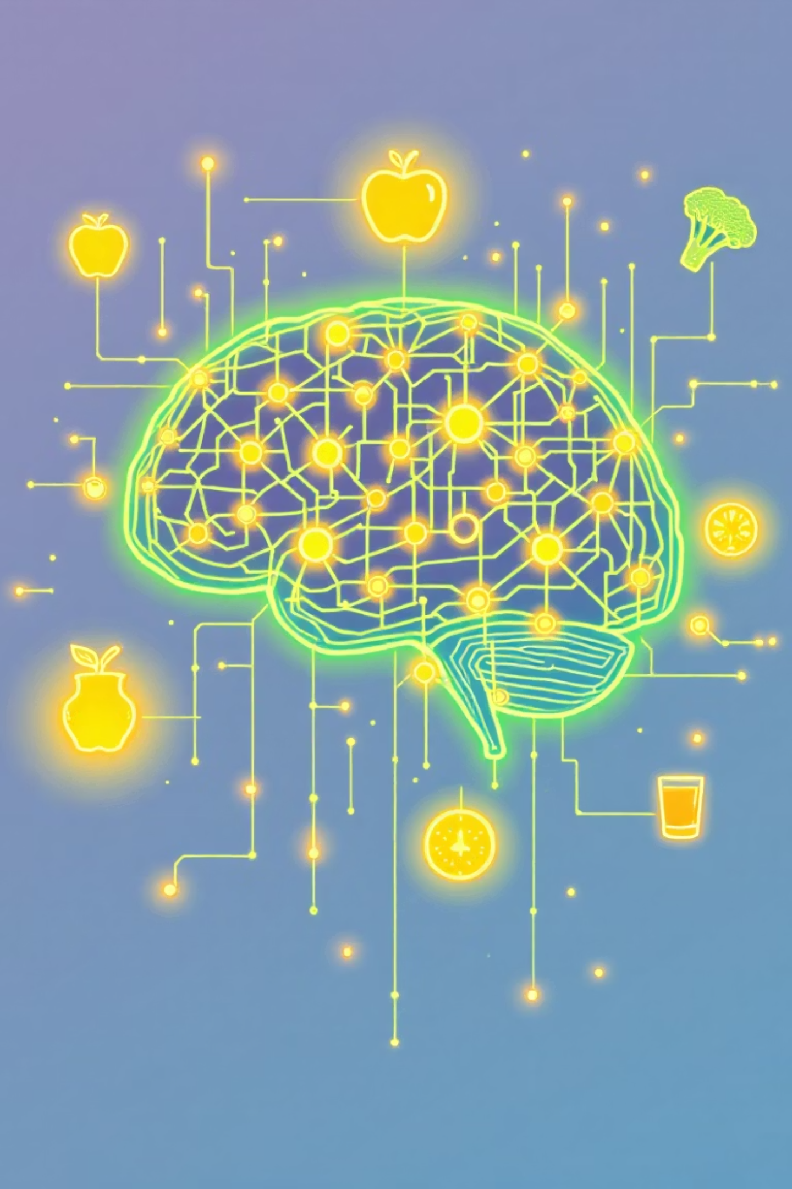
Nutri Mate: A Deep Learning-Based personalized Dietary Recommendation
Presented by: Biswajit Biswal(22CSE377)
Sarada Prasanna Dash(22CSE390)
Rudra Narayan Das(22CSE509)
Supervisor: Murali Kr. Senapty
Domain: Machine Learning

Slide 2
The Quest for Personalized Nutrition: Problem & Objectives
The Problem: A One-Size-Fits-All Approach
Our Solution: Personalized Dietary Recommendations
In today’s world, people are becoming more health-conscious and have different dietary needs. However, general diet advice does not work well for everyone. Many people struggle to understand nutrition, manage health conditions, or achieve personal fitness goals because the advice they get is v not personalized. Existing solutions are either too basic, time-consuming, or not smart enough to adapt to an individual’s lifestyle and health needs. As a result, people often fail to follow their diet plans and face poor health outcomes.
Personalized diet recommendations are very important because they go beyond general health advice. They provide nutrition plans tailored to each person’s needs, whether it’s managing weight, improving athletic performance, or reducing the risk of diseases like diabetes and heart problems. Such a system helps people make better food choices, leading to healthier lives and improved overall well-being.
Primary Objective
Secondary Objectives
Develop a machine learning-based recommender system capable of generating personalized dietary plans.
Integrate diverse user data (health, preferences, activity).
Ensure nutritional balance and dietary restrictions.
Provide adaptive recommendations over time.

Slide 3
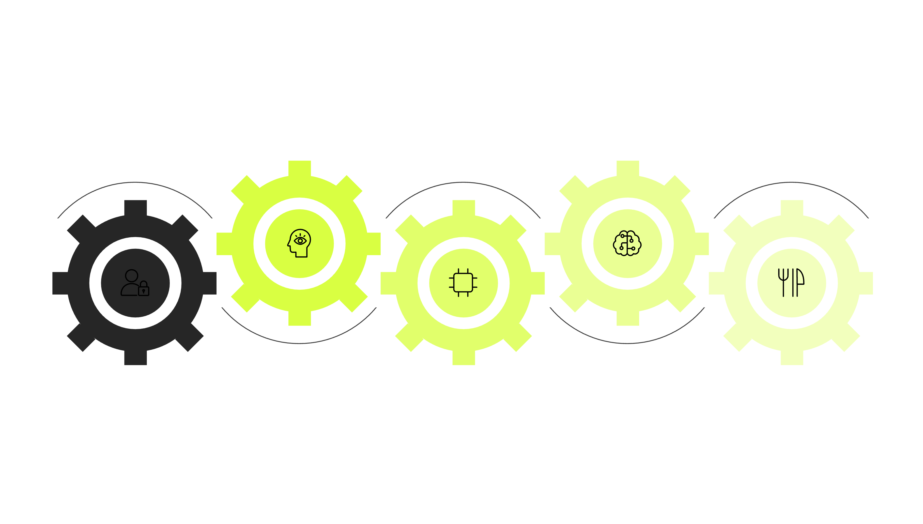

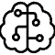

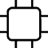
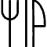
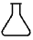

Strategic Blueprint: Our Methodology
Data Preprocessing
Machine Learnig Approch
Algorithms applyed
Clean, normalize, and validate inputs
User Data Input
Feature Engineering
Personalized Dietary Plan
Collect preferences, goals, health metrics
Extract nutritional and behavioral features
Generate tailored meal recommendations
The core of our system is a deep learning model, likely a Recurrent Neural Network (RNN) or a Transformer architecture, capable of capturing complex sequential and contextual dependencies in user behavior and physiological responses. This model will learn optimal food combinations and quantities based on individual health goals, dietary restrictions, and dynamic feedback.
Core Language
Deep Learning Frameworks
Python
TensorFlow, Keras
Data Manipulation
ML Utilities
Pandas, NumPy
Scikit-learn

Slide 4
Data Foundation: Dataset & Requirement Analysis
Primary Dataset Source
Key Features/Parameters Considered
We are leveraging the Personalized_Diet_Recommendations database from the Kaggel.com . This comprehensive database provides detailed nutritional information for a vast array of foods, serving sizes, and food categories.
Nutrient Profiles: Hight, Weight, BMI, Gender, Age . .
User Health Metrics: Age, gender, weight, height, BMI, activity level, existing health conditions (e.g., diabetes, hypertension).
User Preferences: Food likes/dislikes, cuisine preferences, meal frequency.
Allergy & Restriction Lists: Curated lists of common allergens (e.g., gluten, dairy, nuts) and dietary restrictions (e.g., vegetarian, vegan, ketogenic) to inform filtering logic.
Preprocessing Steps
Initial data preprocessing includes cleaning missing values, handling categorical variables through one-hot encoding or embeddings, and normalizing numerical features to ensure optimal model performance.

Slide 5

Milestones Achieved: Progress Till Date
We have made significant strides in the initial phases of the Nutri Mate project, establishing a strong foundation for the machine learning model development. Our progress demonstrates our commitment to delivering a robust and effective dietary recommender system.
01
02
Requirement Analysis Completion
Data Acquisition & Initial Preprocessing
Detailed user stories and functional specifications have been documented, outlining the core features and desired system behavior. This includes defining personalization parameters and interaction flows.
The USDA Food Data Central dataset has been successfully acquired, ingested, and undergoes initial cleaning. Basic handling of missing values and data type conversions are complete.
03
04
Exploratory Data Analysis (EDA)
Conceptual Design & Architecture
Comprehensive EDA has been performed on the food nutrient data to understand distributions, identify correlations, and uncover potential outliers. This informs feature engineering strategies.
High-level system architecture for Nutri Mate, including data flow and module interactions, has been drafted. This includes initial thoughts on model integration.
Overall Work Completed: 25%
This represents the successful completion of foundational planning and data preparation stages, setting the stage for machine learning model implementation.

Slide 6
Architecting Intelligence: Preliminary Design & Algorithms
Our preliminary design outlines the core components and interaction flow of the Nutri Mate system. At its heart lies a sophisticated deep learning architecture designed to capture nuanced relationships between user attributes and nutritional content.
The conceptual design emphasizes modularity, allowing for iterative development and future expansion. The central deep learning model will likely employ an encoder-decoder architecture. The encoder will process diverse user data (health metrics, preferences, activity) into a latent representation, while the decoder will generate personalized meal recommendations by leveraging the comprehensive food database.
Model Type: Logistic Classification
Potential Enhancements: Transformers
Combines collaborative filtering (user-user similarities) with content-based filtering (food nutrient profiles) through machine learning embeddings.
Investigating Transformer architectures for sequence-aware recommendations, allowing for dynamic adjustments based on previous meal choices and real-time feedback.
Algorithm Core: Random Forest
Extends matrix factorization with learn non-linear user-item interactions, optimizing for ranking.

Slide 7
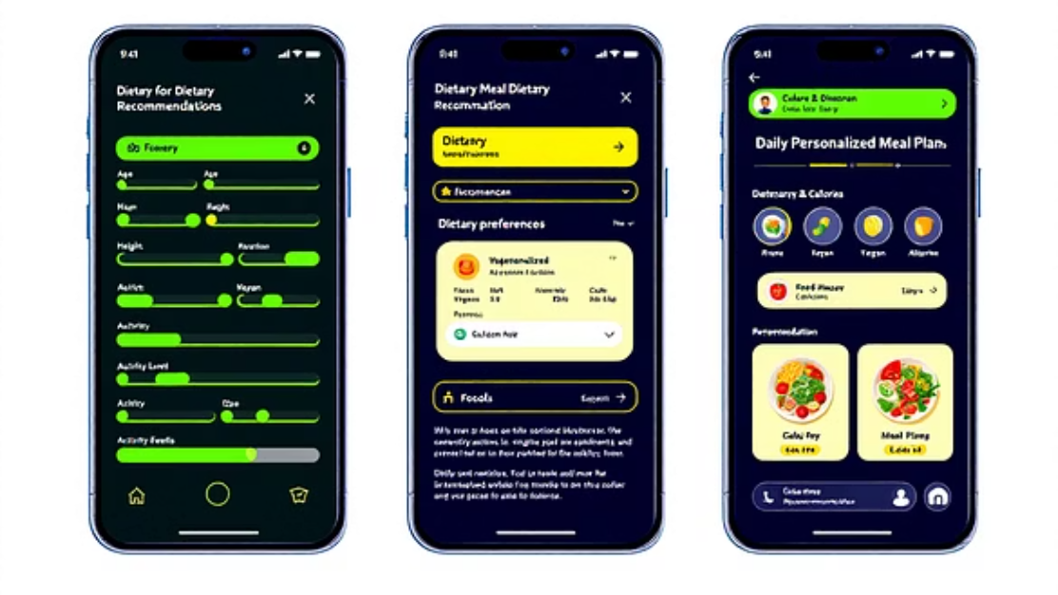
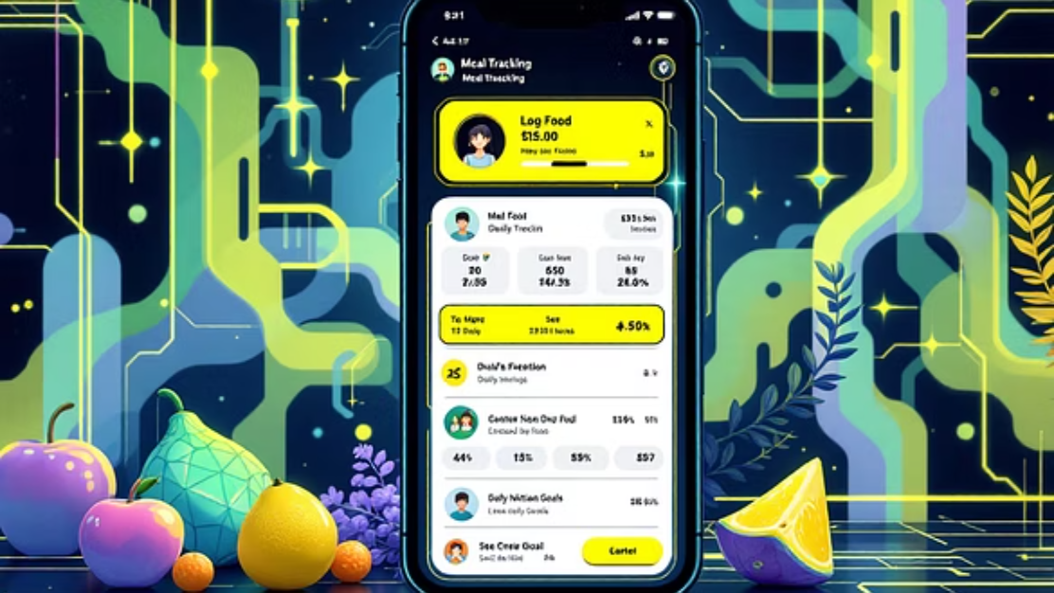
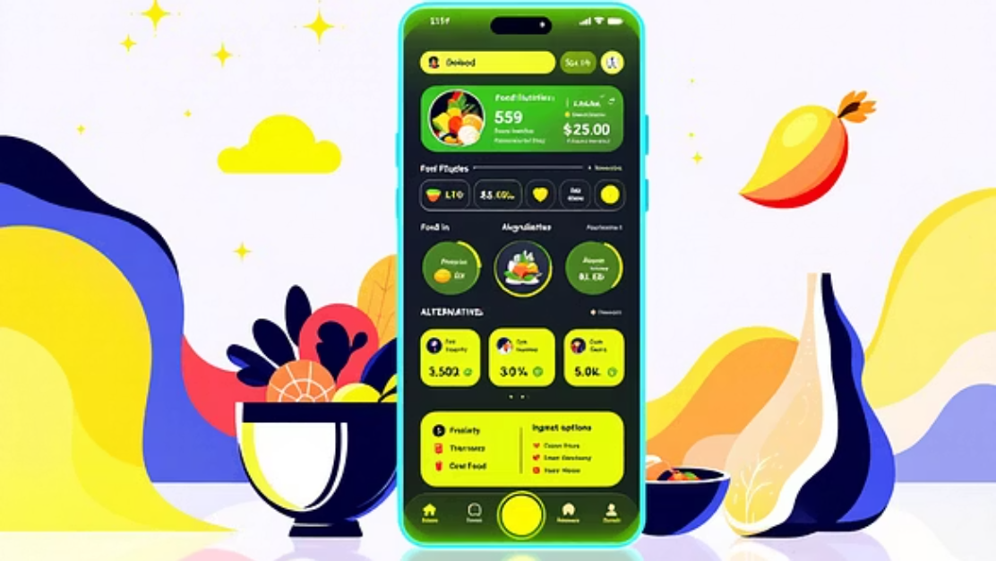
Nutri Mate in Action: User Interface Mockup
While the primary focus remains on the machine learning core, a user-friendly interface is crucial for practical application. Here's a glimpse of the anticipated user experience, designed for intuitive data input and clear recommendation presentation.
The interface will guide users through initial profile setup, including health metrics and dietary preferences. Post-setup, the main dashboard will display personalized daily meal plans, along with options to log food, track progress, and adjust preferences. The goal is a seamless interaction that makes personalized nutrition accessible to everyone.

Slide 8
Looking Forward: Expected Contributions & Novelty
As we advance towards the completion of Nutri Mate, we anticipate several key contributions to the field of personalized nutrition and machine learning. Our project aims to fill critical gaps identified in existing research and offer a robust solution with significant real-world impact.
1
2
Adaptive Recommendation Engine
Holistic User Profiling
Unlike static rule-based systems, Nutri Mate will feature a deep learning model capable of continuous learning and adaptation based on user feedback and evolving health data, ensuring recommendations remain relevant over time.
Integration of a wider array of user data – beyond just dietary preferences to include activity levels, chronic conditions, and even potential genetic predispositions (future scope) – enabling truly bespoke recommendations.
3
4
Nutrient Interaction Optimization
Scalability & Generalizability
The deep learning model's ability to learn complex patterns will allow it to optimize for beneficial nutrient interactions and avoid detrimental combinations, a nuanced aspect often missed by simpler systems.
Designed with scalability in mind, the deep learning architecture can theoretically handle large datasets and diverse user populations, making it applicable across various health and wellness contexts.
The novelty lies in our commitment to an end-to-end deep learning paradigm for highly personalized and dynamic dietary recommendations, moving beyond traditional recommendation system limitations.

Slide 9
Conclusion & Next Steps
Nutri Mate is poised to revolutionize personalized nutrition by harnessing the power of deep learning. We've laid a solid foundation through meticulous requirement analysis, comprehensive literature review, and a robust preliminary design.
Model Training & Validation
User Acceptance Testing
Implement and train the deep learning model using the preprocessed data, followed by rigorous validation using appropriate metrics.
Conduct user trials to gather feedback, identify areas for improvement, and fine-tune the recommendation algorithm based on real-world usage.
1
2
3
4
System Integration
Refinement & Future Work
Integrate the trained model with a user interface, creating a functional prototype for testing and demonstration.
Iteratively refine the model and interface. Explore advanced features like real-time physiological data integration and meal preparation guidance.
"The journey of a thousand miles begins with a single step. Our work on Nutri Mate is that pivotal step towards a healthier, more personalized future."
Thank you. Questions?

